Slide 1
SKKU Lab Recommendation Service : FindMyLab
Team J (Last Lap) 김현진 송민석 장민석 조재희
2024-Fall Capstone Design Project

Slide 2
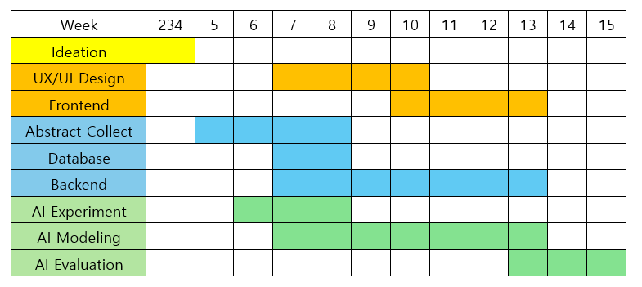
1. Objectives & Milestones
2024-Fall Capstone Design Project
Team J (Last Lap) 김현진 송민석 장민석 조재희

Slide 3
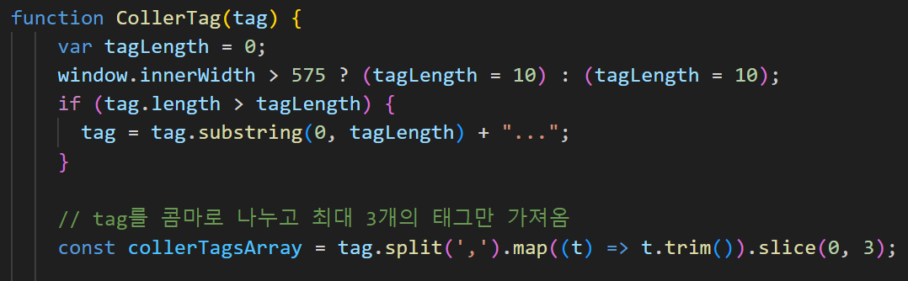
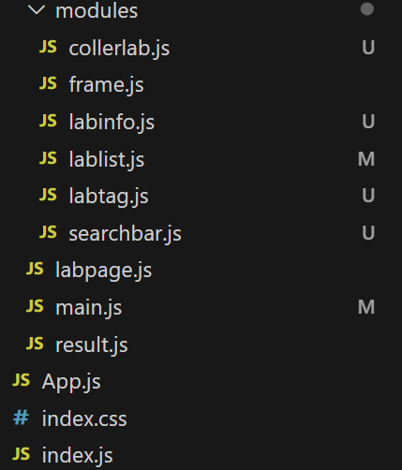
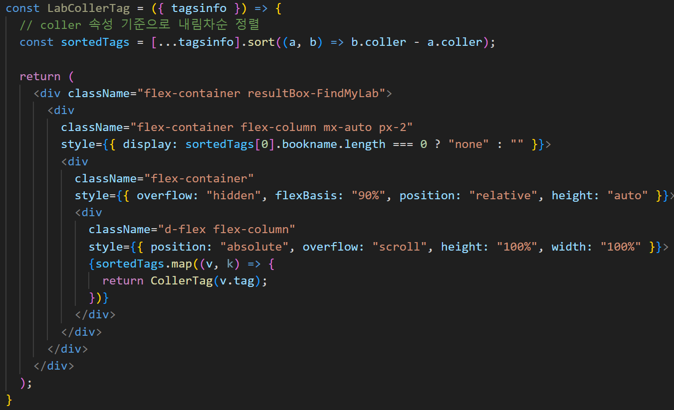
2. Frontend / Component-Based Abstraction
2024-Fall Capstone Design Project
Team J (Last Lap) 김현진 송민석 장민석 조재희

Slide 4
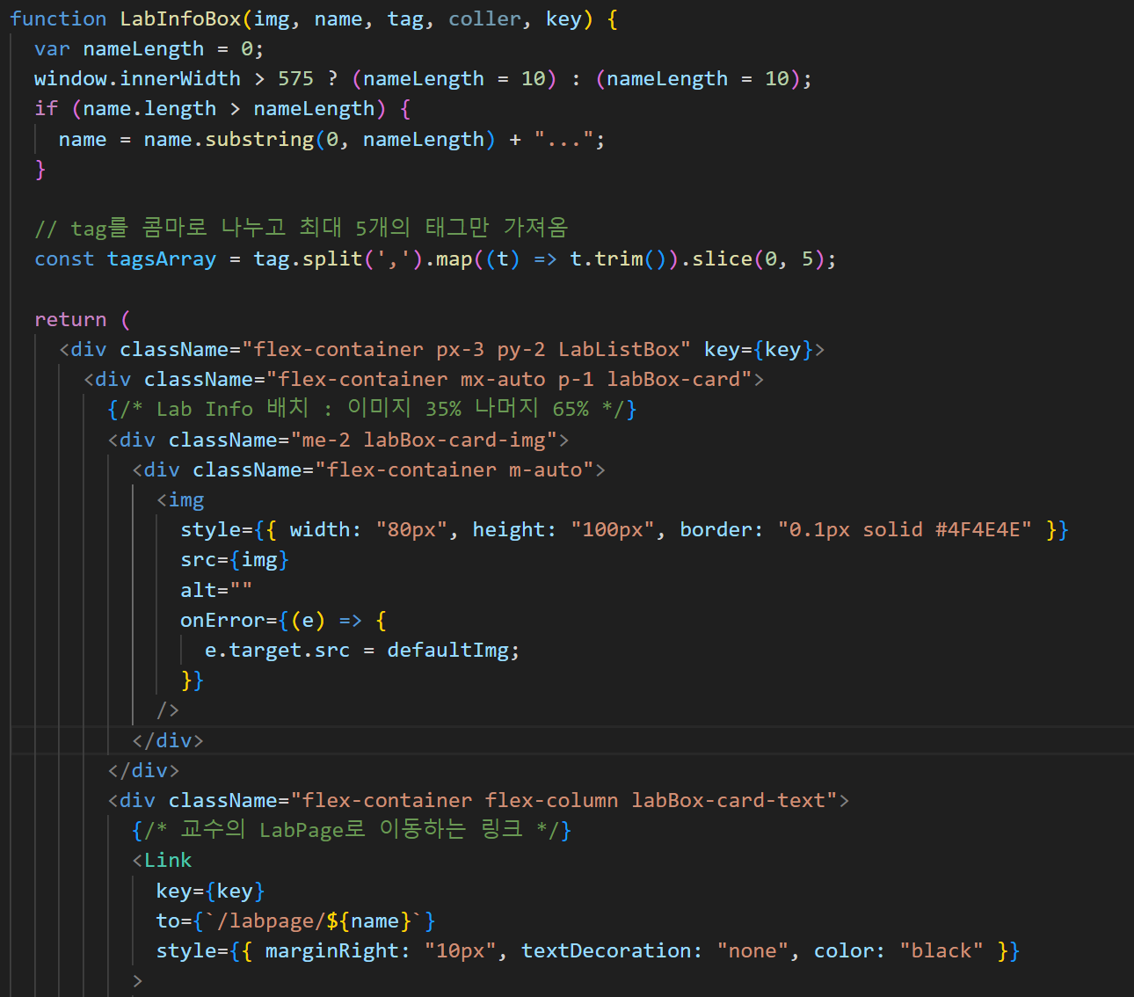
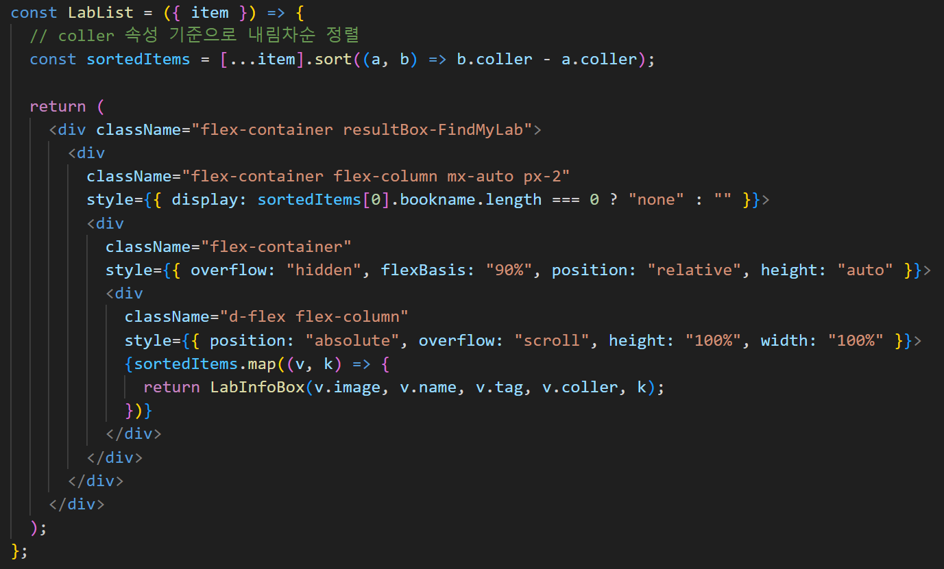
2. Frontend / Parameterization
2024-Fall Capstone Design Project
Team J (Last Lap) 김현진 송민석 장민석 조재희

Slide 5
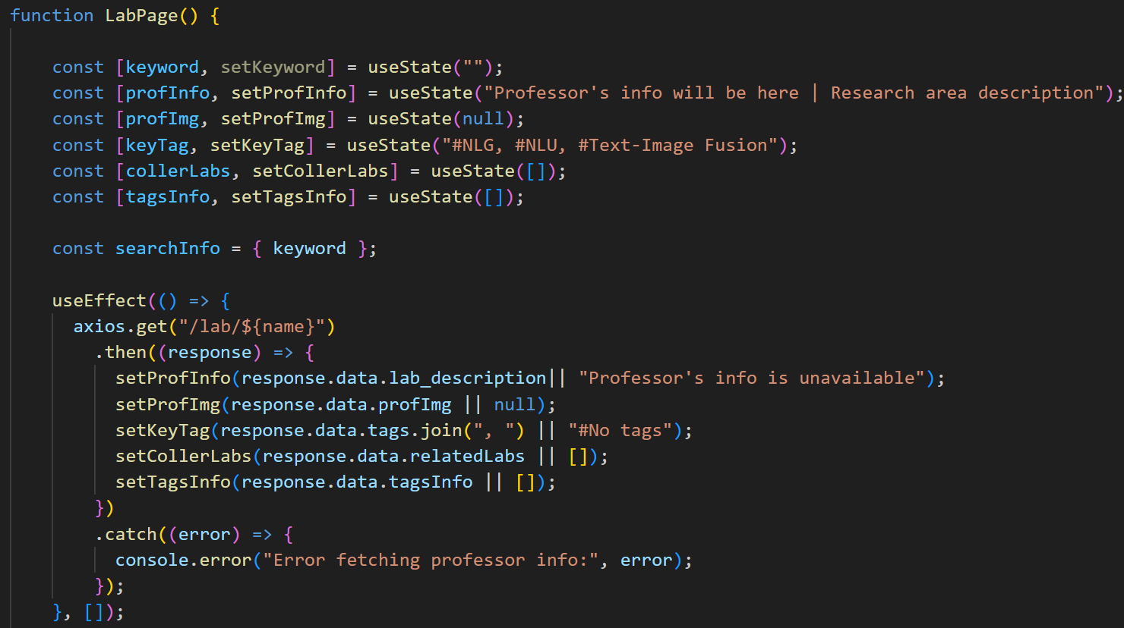
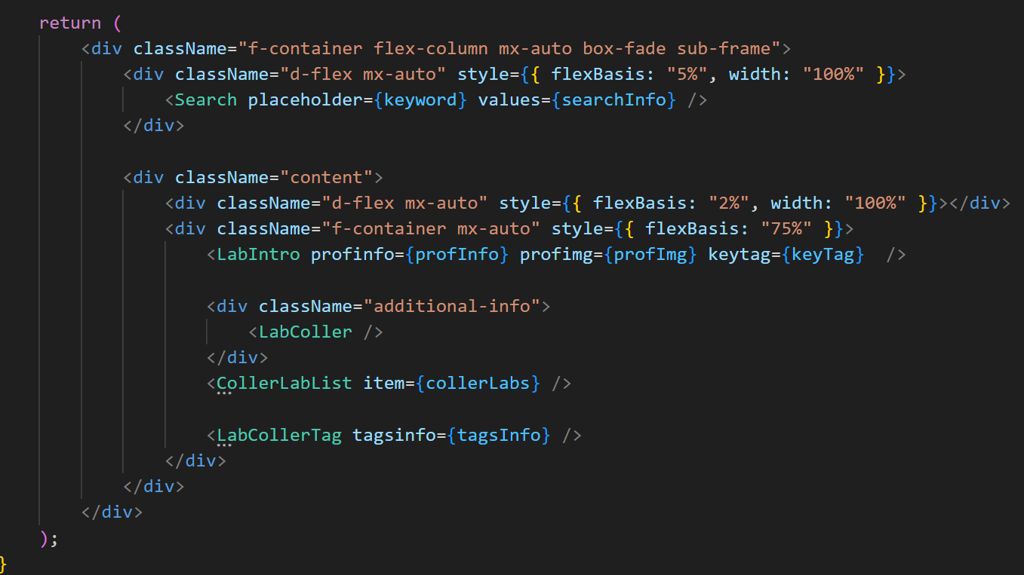
2. Frontend / State-Driven UI
2024-Fall Capstone Design Project
Team J (Last Lap) 김현진 송민석 장민석 조재희

Slide 6
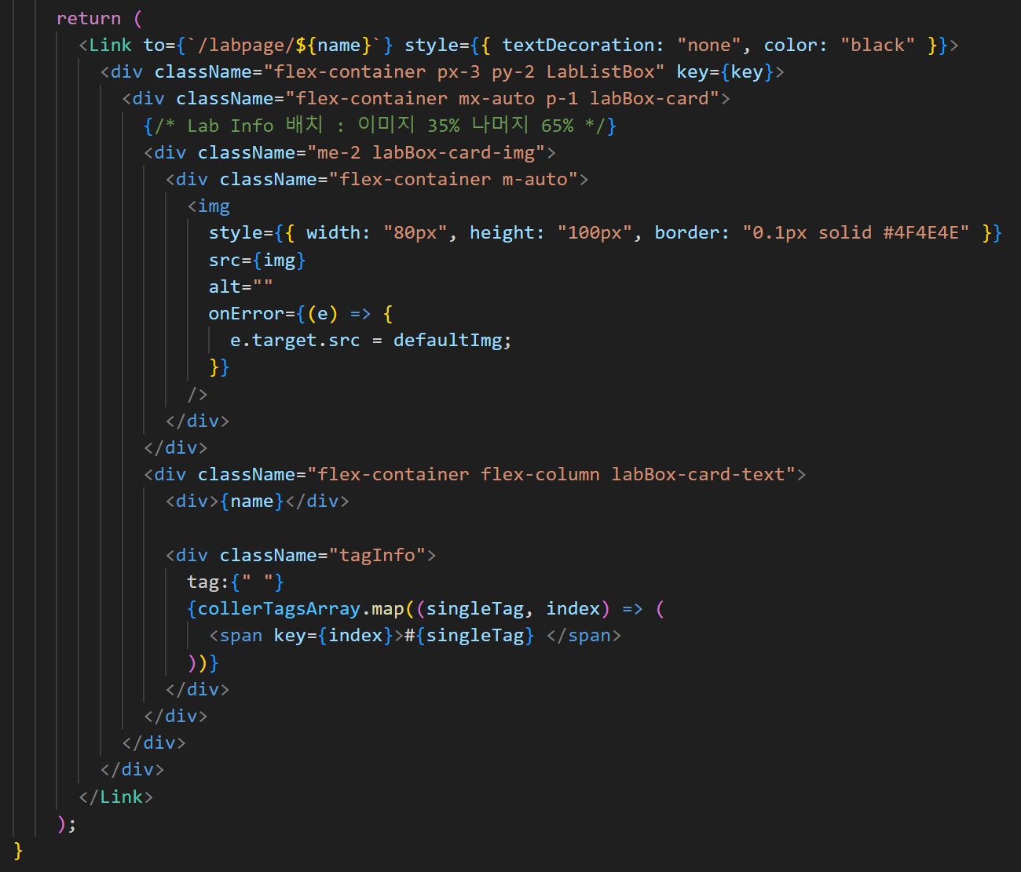
2. Frontend / Hierarchical Structure
2024-Fall Capstone Design Project
Team J (Last Lap) 김현진 송민석 장민석 조재희

Slide 7

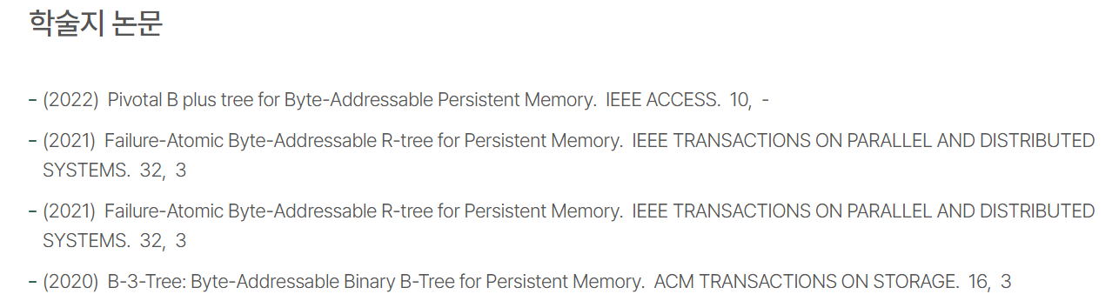
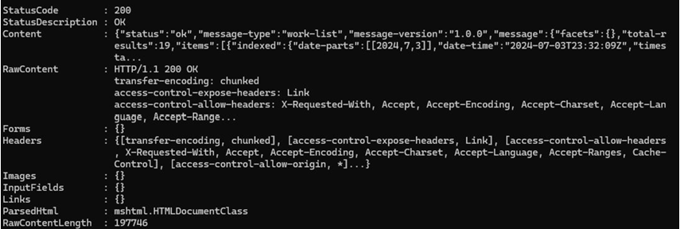
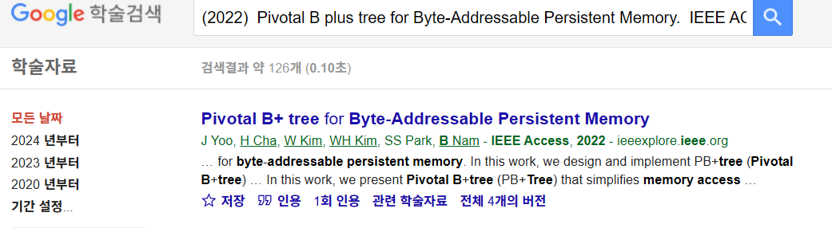
3. Backend / Abstract Extract – previous algorithm
[Crossref API]
2024-Fall Capstone Design Project
Team J (Last Lap) 김현진 송민석 장민석 조재희

Slide 8
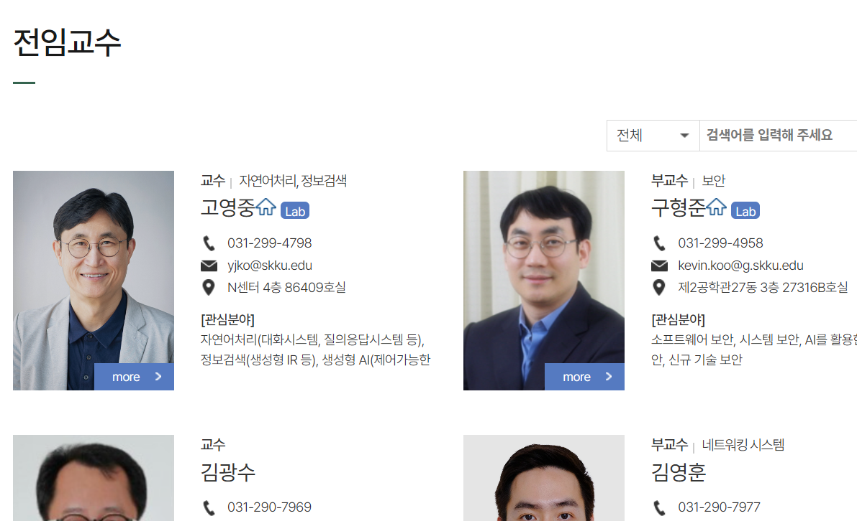
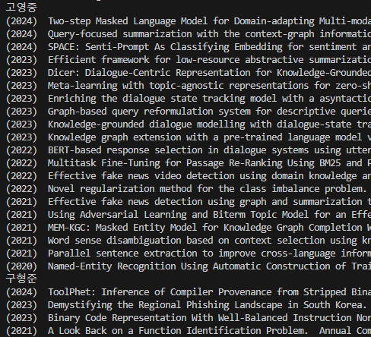
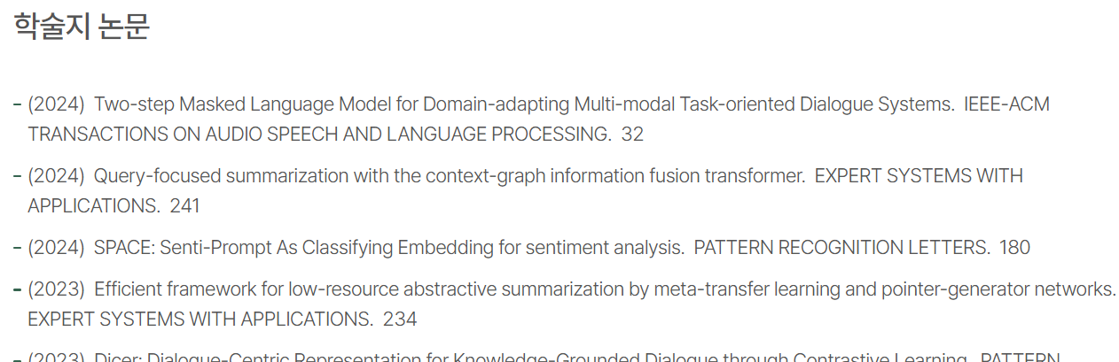
3. Backend / Abstract Extract – SKKU Web Crawling
[SKKU Computer Science Web Site]
[Crawling Data]
2024-Fall Capstone Design Project
Team J (Last Lap) 김현진 송민석 장민석 조재희

Slide 9

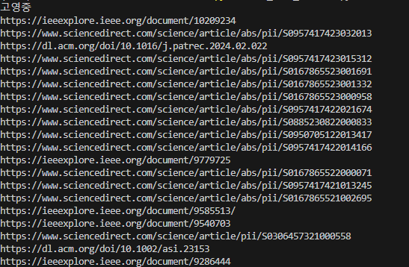
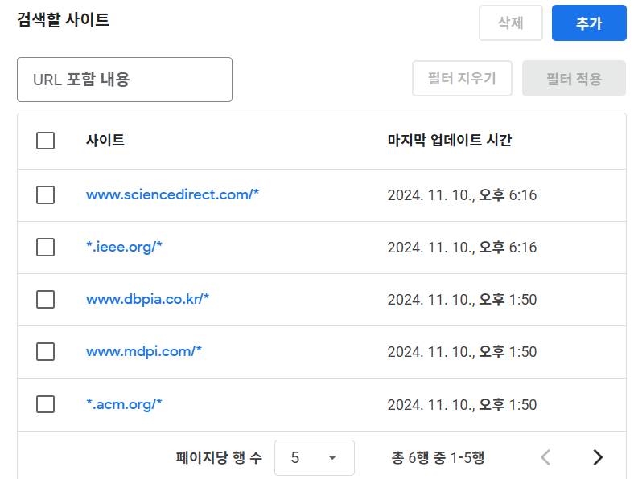
3. Backend / Abstract Extract – Custom Search API
Custom Search API
[Custom Search Engine]
[URI Data]
2024-Fall Capstone Design Project
Team J (Last Lap) 김현진 송민석 장민석 조재희

Slide 10
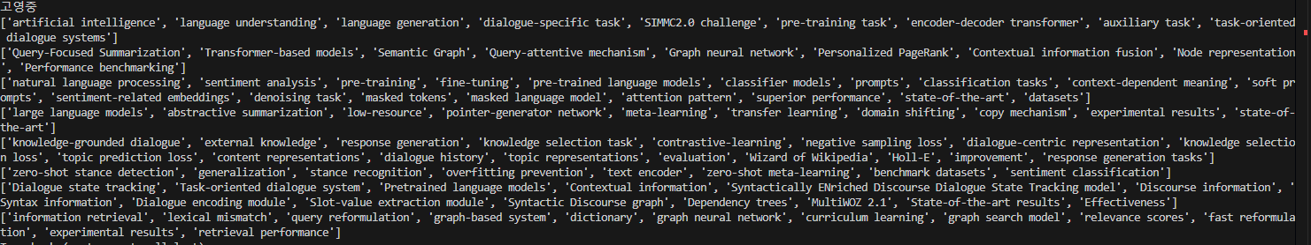
3. Backend – Abstract Extract – GPT prompting
Prompt
Read the abstract of the provided research paper and return the {field} core technology and classification in a list format. Provide only concise keywords or phrases for each response item without full sentences.Read the abstract of the provided research paper and return the core technology and classification as a single, combined list of keywords in array format, without any headings or categorization
2024-Fall Capstone Design Project
Team J (Last Lap) 김현진 송민석 장민석 조재희

Slide 11
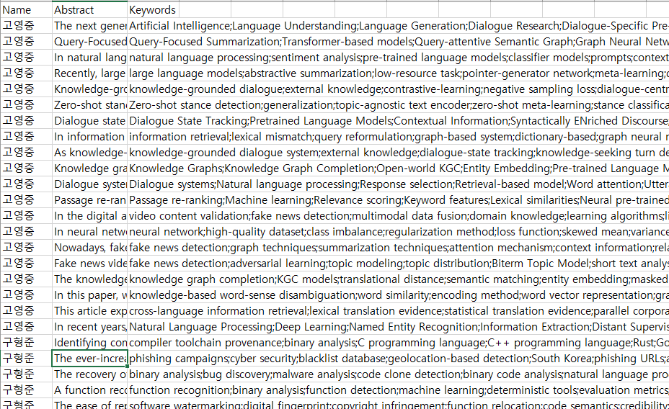
3. Backend – Abstract Extract – GPT prompting
2024-Fall Capstone Design Project
Team J (Last Lap) 김현진 송민석 장민석 조재희

Slide 12
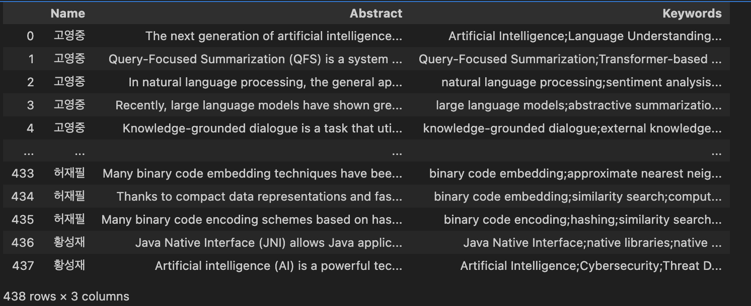
4. AI / Search Algorithm
Model
SBERT – nil pretrained model
Data
NAME | Abstract | Keywords
고영중 | The next generation.. | Artificial intelligence, Language ..
고영중 | Query-Focused Summarization is a system… | Transformer-based..
..
…
황성재 | Java Native Interface allows Java… | Native libraries, Java Native interface
2024-Fall Capstone Design Project
Team J (Last Lap) 김현진 송민석 장민석 조재희

Slide 13
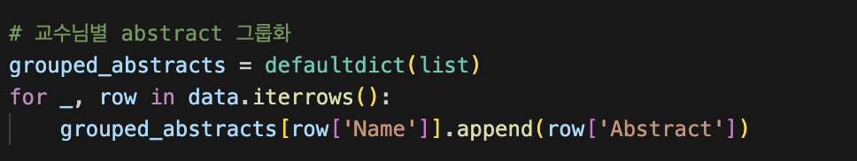
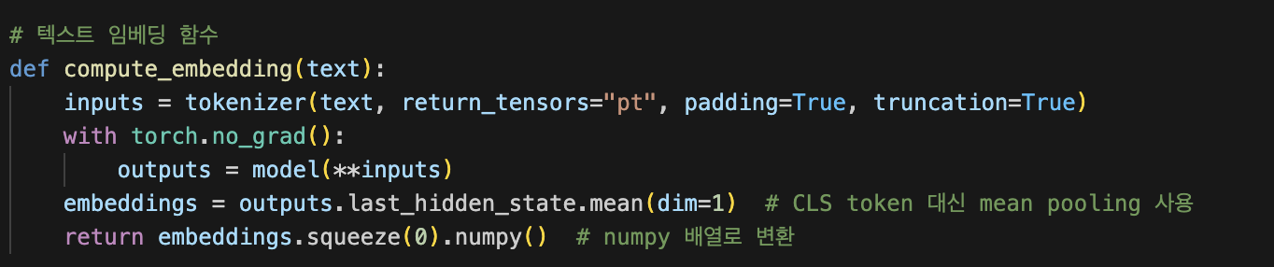
4. AI / Search Algorithm
Prof’s feature
1) grouping abstract → Organized by professor
2) mean pooling
2024-Fall Capstone Design Project
Team J (Last Lap) 김현진 송민석 장민석 조재희

Slide 14
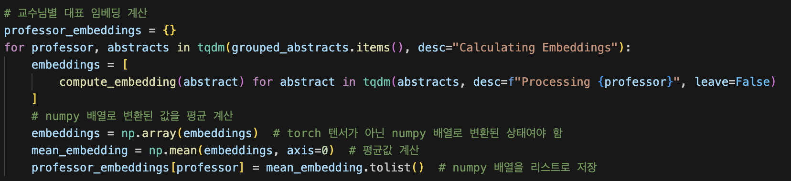
4. AI / Search Algorithm
Prof’s feature
3) call the function : Calculating representative embeddings for each professor
time cost: # of 438 abstract, # of 34 prof => about 10minutes
2024-Fall Capstone Design Project
Team J (Last Lap) 김현진 송민석 장민석 조재희

Slide 15
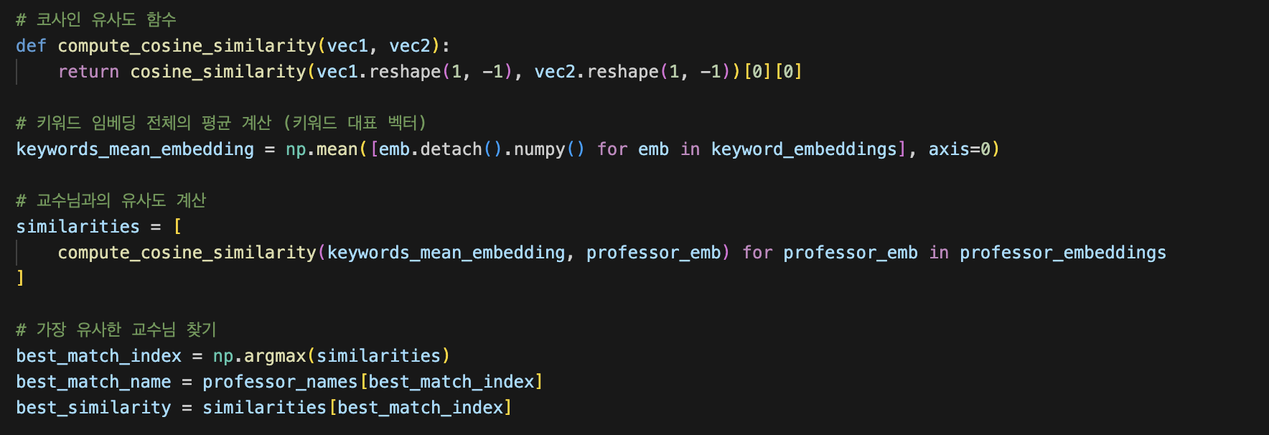
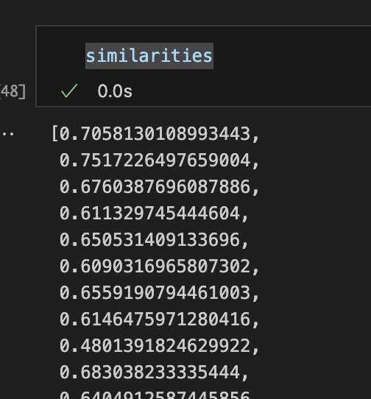
4. AI / Search Algorithm
Search
calculate cosine similarity between search keywords and professor embedding
<similarity result>
2024-Fall Capstone Design Project
Team J (Last Lap) 김현진 송민석 장민석 조재희

Slide 16
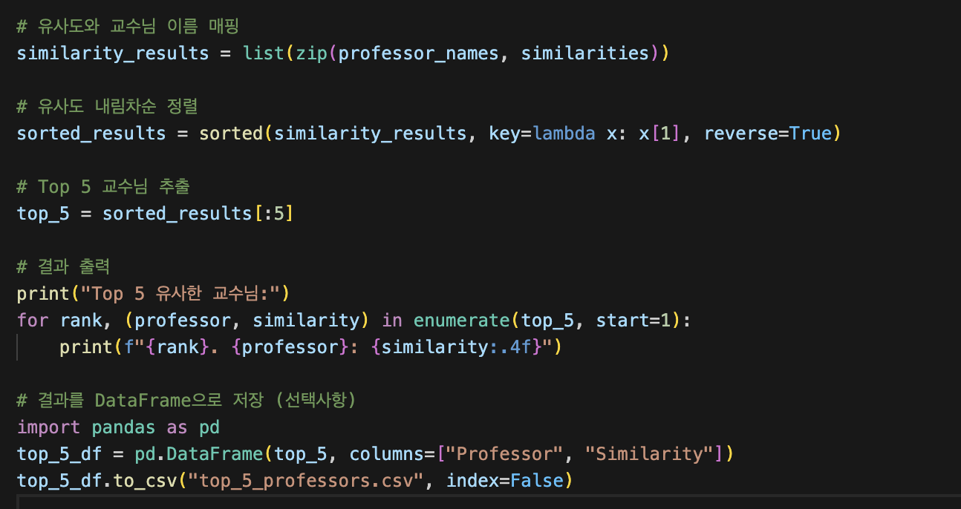
4. AI / Search Algorithm
Search top 5
The extracted similarity list is obtained by sorting in descending order.
2024-Fall Capstone Design Project
Team J (Last Lap) 김현진 송민석 장민석 조재희

Slide 17
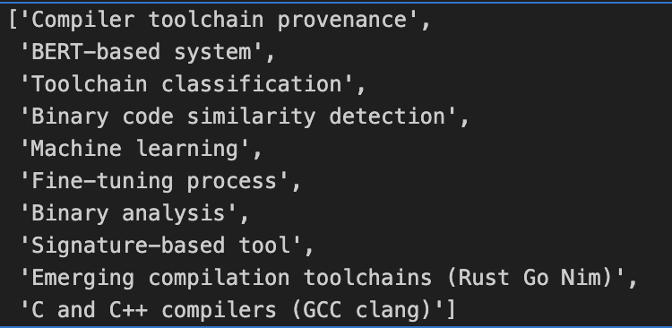

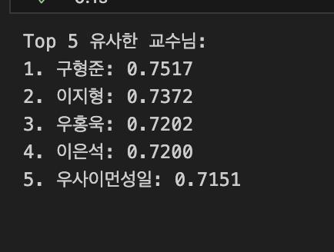
<top 5 search result>
4. AI / Search Algorithm
Example
search keywords
<search result>
<top 5 search result>
2024-Fall Capstone Design Project
Team J (Last Lap) 김현진 송민석 장민석 조재희

Slide 18
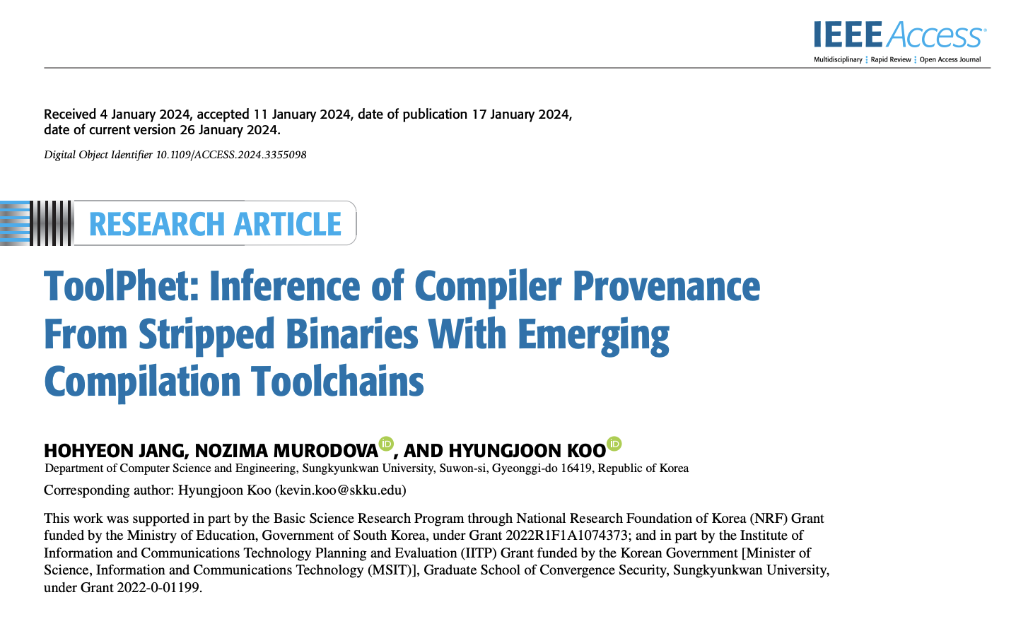
<top 5 search result>
4. AI / Search Algorithm
Example
The keywords are highly similar to those used
in Professor Koo Hyungjun's actual research papers
2024-Fall Capstone Design Project
Team J (Last Lap) 김현진 송민석 장민석 조재희

Slide 19
Q & A
2024-Fall Capstone Design Project
Team J (Last Lap) 김현진 송민석 장민석 조재희
Notes:
-

